Slide 1
What is the next step of YANG effort in IETF: Service Oriented YANG Pilot Project?
Qin Wu
Huawei

Slide 2
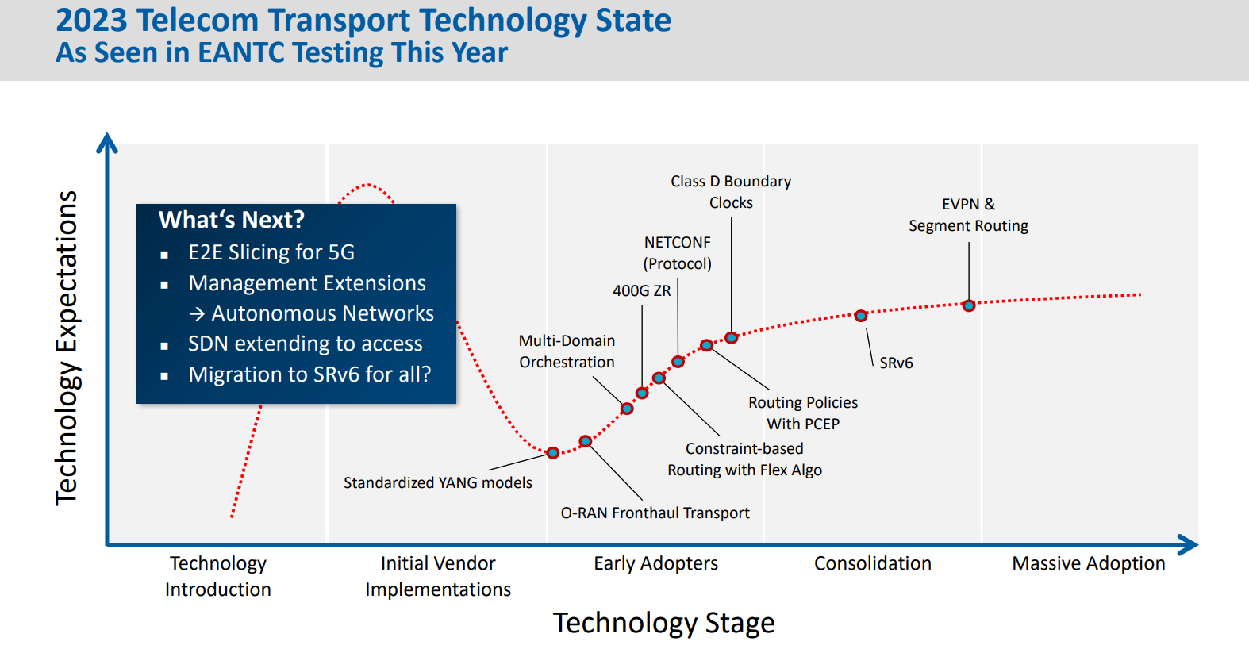
Where we are for YANG adoption in Industry
Observation 1: Slow Adoption
Of Device Level YANG
Observation 2: Fast Adoption of
Service/Network Level YANG
EANTC launched NETCONF/YANG Multi-vendor Interoperability Test starting from 2016, Test every year since 2016,
The main use cases :L3VPN service provision, L2VPN service provision.
Addition Use cases (2023): NETCONF transport slicing, system inventory, routing policy configuration
The referenced IETF models : L3SM,L2SM, Network slicing service model in TEAS WG, etc
Opeconfig YANG, Native YANG and IETF YANG at device level;

Slide 3
IETF YANG Model Standardization Journey
Service Level/Network Level
YANG Model Work
Camara NaaS was Launched at MWC at Feb 2022
Service assurance and monitoring model gets attraction such as Service assurance YANG, VPN PM YANG, SAP YANG, Attachment Circuit, etc
Model versioning for individual YANG matured, YANG package ongoing
Some leading operators experiment IETF YANG using open source or PoC project
2022~ Now Where we are now YANG adoption Catalyst
L3SM/L2SM WGs
LIME,I2SNF WGs, and ACTN
Network Slicing BOF coordinated with 3GPP and pushed back a lot
Each WG in routing area creates protocol specific YANG design team
Routing YANG Architecture Design Team setup to align with Openconfig and was closed down in 2018
IETF YANG Coordination Group was formed to provide tooling and coordination within IETF
YANG Catalog were kicked off to Provide tooling and easy use way to find YANG models
2014~2018 SDN NBI/SBI YANG Flourishes
Device Level
YANG Model Work
RFC8969 guidance for YANG integration at different level
L3NM and L2NM Design Team Work
IETF Network slicing design team formed
YANG versioning DT is setup around May, 2018
Slow adoption of Device Level VPN YANG such as EVPN, L2VPN,L3VPN and QoS
2019~2021 SDN NBI continue to grow interests，Slow adoption of IETF SBI YANG
100+ YANG data models developed by Open Daylight
YANG data model considered in Most of protocol specific WGs in Charter
Routing Management YANG -> foundation for all routing protocol models
2014 YANG Takes Off in Industry

Slide 4
Challenging and Issues of Implementing YANG
Gap with Industry needs
Many operators are not engaged enough in the IETF to create that perfect world.
Except Service model work
Operators has more voice in opensource community, e.g., Openconfig
Slow IETF process makes technology integration lengthy
The operators expected to deploy these technologies often don't even know that the standards are being developed.
YANG Catalog and provide visibility to IETF YANG and makes difference a lot
The operators who know that the standards are being developed may not know how these models work together to configure a device, manage a set of devices involved in a service.
No Service Oriented Cook Book
YANG Integration Samples
This lead to critical new technologies currently being developed without sufficient direct operator input.

Slide 5

What have already been done with IETF YANG
Phase 1: Engaging Operators: Develop Service Level API related YANG Data
Model Work, such as L3SM, L2SM, I2NSF; Develop Generic Policy YANG Model
that works at different level such as SUP
Phase 2: Setup YANG Catalog to provide a reference for all YANG modules
available in the industry
Phase 3: YANG Model Integration Guide: Develop model driven automation
framework to provide guidance For building fully automated YANG based System;
Phase 4: Develop Network Level API related YANG data model such as L3NM
,L2NM, Network Slicing, SAP(Service Attachment Point), VPN NBI PM, etc
Phase 5: Setup Service Driven YANG Pilot project to catalyze YANG adoption
In the industry:
Network Inventory Initiative looking for alignment with different SDOs and
Open source project
Teraflow Transport Controller Project driven by Telefonica
Data Mesh open source project driven by Swisscom
SRv6 Visibility Project driven by Swisscom
APP
APP
APP
L2/L3SM WG
NBI
L3SM
L2/L3VPN/VN/TE Service Mapping
OPSAWG WG
Customer
Orchestrator
L2NM,L3NM, UNI Top Model
TEAS WG
Architecture, Generic TE Models
I2RS WG
NBI
L3NM
Generic Network Topo Models
IDR WG
BGP Policy and BGP-LS
SDN Controllers
PCE WG
PCE Protocol
BESS WG
L3VPN/EVPN/L2VPN
SBI
NETCONF WG
NETCONF/RESTCONF
NETMOD WG
YANG Language
Fundamental

Slide 6
Application and Network Collaboration among telco operators, vendors and hyperscalers
Camara NaaS was Launched at MWC at Feb 2022 and Operated for one year.
Our understanding of CAMARA
Carriers & Vendor joint activities
Use Case Catalog(planning)
MBB
Quality on Demand
Device Location
Device Status
FBB
Home Devices Quality on Demand
Optical private line Quality on Demand
1
“0-Touch” 5G Mobile ATM Services
Mobile Game Acceleration
Download Acceleration Services(BoD)
Mobile Device location
Use case Scenario
Service API
Service API Gateway
Service API Practice
Service Applications
Unified and E2E Service Orchestrator with API exposure
Developers and Product Manager User Story
Service API joint-Definition
Transform Function
Network API (IETF, BBF, IEEE, TMF)
Network API Gateway
Network API Implementation
Autonomous Network
3
Autonomous Network UC
NFs + NEF APIs
5G Slicing + Network APIs
Network API Standardization
Network Resources
NEF
Controller
Controller
Controller
Controller
4/5G Radio & Core
Transport (Optical，IP)
ACCESS

Slide 7
Model Correlation Relationship Overview
Correlation via Augment
Fulfill
Correlation via Mapping
Assurance
Service Level Models:
IETF Attachment Circuit Service Model
IETF Bearer Service Model
L3SM
L2SM
L1CSM
IETF Transport Slice Service
Mapping
TE Service Mapping
Mapping
TE VN Model
Slice Service Mapping
Network Level Models:
IETF Attachment Circuit Network Model
Mapping
Mapping
Augment
L3 Topo
L2 Topo
TE Topo
DC Fabric Topo
SAP/UNI Topo
Network Performance Monitoring
Network Slice Topo
TE Tunnel Telemetry
Augment
Augment
IETF Network Topo Model
Network Inventory
Model
L3NM
L2NM
NRP
Network Device
Model
TE Tunnel
Augment
Mapping
IETF Network Model
Device Level Models:
Service Level Model
Service Layer:
L2VPN
L3VPN
EVPN
MVPN
Orchestrator
Routing Layer:
BGP
OSPF
ISIS
RIB
SR/SRv6
Network Level Model
Network Level Topo Model
Controller
Policy Layer:
ACL
QoS Policy
Routing Policy
SR
Policy
Device Level Model
OAM/PM:
BFD
IPFIX
TWMAP
IOAM
BMP
Orchestrator
Notes:
This slides show the whole picture of Network Inventory. In this picture, not only we can see Network Inventory models but also we can its periphery neighboring models, These models can be break down into three level models, Service Level, Network Level and Device Level.
Network Inventory is placed in the NBI of SDN controller together with Network Level Models such as L3NM, L2NM.
In addition, we see, model relation can be established using correlation, there are two type of correlation, one is correlation based on augment,
The other is correlation based on mapping.
Typical example of correlation based on augment is network model defined in RFC8345 has been extended for L3 topo, L2 topo and network inventory.
Typical example of correlation based on mapping is we define a separate model,e.g., TE service mapping to map L3SM into TE Tunnel or VN model. We also can not define explicit dependency relation between service model and device model, let vendor or operators themselves decide.

Slide 8
Network Device Anatomy
Network Device YANG Logical Organization
Source: https://datatracker.ietf.org/doc/html/draft-ietf-rtgwg-device-model-02
Sample Network Device Architecture Design
Service Plane
(Data Plane/Control Plane/Management Plane)
YANG configuration data Container
Network Device (Physical or Virtual)
Network
Device
Network Service Layer
L3VPN
L2VPN
EVPN
SDWAN
5G Slicing
Logical Network Element
Logical Network Element
Network Protocol Layer
Network
Instance
Network
Instance
Network
Instance
Network
Instance
Network
Instance
Network
Instance
Configuration Data Layering
SR/SRv6
BGP
OSPF
ISIS
Network Policy Layer
ACL
QoS Policy
Routing Policy
Security Policy
Interfaces
Interfaces
Network Resource Layer
Interface Mgmt
QoS Queue Mgmt
Tunnel Mgmt
Topo Mgmt
L2VPN
L3VPN
EVPN
MVPN
Network Infrastructure
BGP
OSPF
ISIS
RIB
SR/SRv6
System Management Layer
ACL
QoS Policy
Routing Policy
SR
Policy
Software
And hardware
Inventory Data
System Info
Software Install&Update
System Process Monitoring
BFD
IPFIX
TWMAP
IOAM
BMP
System Inventory Object Layer
Device Mgmt
Logical System Mgmt
System Component Mgmt
Notes:
So what is inside of network device. I think we can break down network device related data into multiple layers, e.g. service layer, protocol layer, policy layer, system management layer, system inventory object layer. In these layers, the bottom two layer related to network infrastrucuture,
Clearly distinct with other layers in the control plane, forwarding plane and management plane.
Also we can refer to Network Device Model defined in RTGWG WG which never get published. But it provide encapsulation layer or envelop layer to organize configuration model at the device layer together. The encapsulation layer include logical network element which is related to vRouter, vfW.

Slide 9
Network Inventory Functional Overview
In scope of IVY WG
Beyond scope of IVY WG
Basic Network Inventory Functionalities
Logical Network Inventory
Application Software
Physical Location Management
Hardware Component Management
Files
Geo Location Management
IP address/Prefix Pool
License Management
System Software Component Management
RD Pool,etc
Network Element Management
Physical Port Management
VLAN Pool,etc
Logical Element Management
Physical Connection Management
Zone List/Region List,etc
……
Notes:
Here is the Network Inventory Function view, based on Network device anatomy, we can see the network inventory MUST include
Both physical network element but also logical network element, in addition, it include physical hardware component, but also
System software component, what is not in the scope of IVY include application software, Files, IP address pool which are more related
To logical network inventory data.

Slide 10
Basic Network Inventory vs Logical Network Inventory
Logical Network Inventory
Service Layer: RT, RD, BGP Community, VRF, BSID, etc.
IP Layer: IP address Pooling, loopback interface, Trunk interface, Device Role, src address, dst address, DSCP, VLAN ID, Sub interface, Zone list, etc.
Basic Network Inventory
Software components: firmware image, OS, bootloader, etc.
Hardware components: processors, memory, physical port, optical module
Network Infrastructure: Network Element such as Router, Switch and Endpoint Device such as PoE device, Camera, etc., or Fiber Optical Cable?
Physical Location and Position: Geo-location, Room, Shelf, Rack, etc.
Tunnel Layer: VXLAN Tunnel, SRv6 Tunnel, TE Tunnel, GRE Tunnel, Gene Tunnel, etc
Application Layer: Application software Name, file name, etc.
License Information: Expiration date, issue date, license id
Policy Layer: Tunnel Policy Profile, QoS Policy Profile, Route Policy Profile etc.
Notes:
So we can break down Network inventory into basic network inventory and logical network inventory. Logcial Network inventory
Can also break down into multiple each layer, the key element in each layer is resource Identifier such as IP address, VLAN or the number of specific resource e.g, the numbe of IP addresses in IP address Pool.

Slide 11
How can we do better for network operators and Developers
Within IETF, Continue to create dedicate working group to define common building block which can be reused in different SDOs, open source projects E.g., Network Inventory to align with ONF, ITU-T SG15, Openconfig
E.g., Network Attachment Circuit to align with ORAN and look for it be reused by L3SM/Network slicing service model work
E.g., YANG Package Versioning work
Externally, more open source projects driven by operators to adopt and verify IETF defined YANG data model and look for missing pieces
collaboration with Camara NaaS API projects
more open source automation tool and documentation to be public available

Slide 12
How can we do better for network operators and Developers
Coordinate with BBF, IEEE, MEF, 3GPP, ETSI for data modeling work
Another IAB workshop on Data model integration and deployment Update
Coordinate requirements and support for existing SDOs developing standards relevant to YANG
Discuss YANG model fragmentation at the device level such as IETF YANG, Openconfig YANG, Native YANG
Explore the limitation and restriction of existing YANG modelling language
Explore How IETF YANG, and other SDO YANG are related to CAMARA NAAS API
Investigate automation tool for DSL modelling translation, e.g., mapping NGSI-LD into YANG
Look for new modeling technology, e.g., Knowledge modelling using RDF

